Slide 1
Most contract manufacturers assemble prototypes,
few embrace the work like APX.
We attack the challenges of prototyping new products.
We are committed to accomplishing the dreams and goals of our clients.
We offer flexible scheduling to balance cost with delivery

Slide 2
Who we are
A contract manufacturer of electronics, based in southern California
Serving multiple industries
A highly capable team with decades of experience.
Committed to building long term relationships with clients
Strong relationships with our technology partners to help in every way

Slide 3
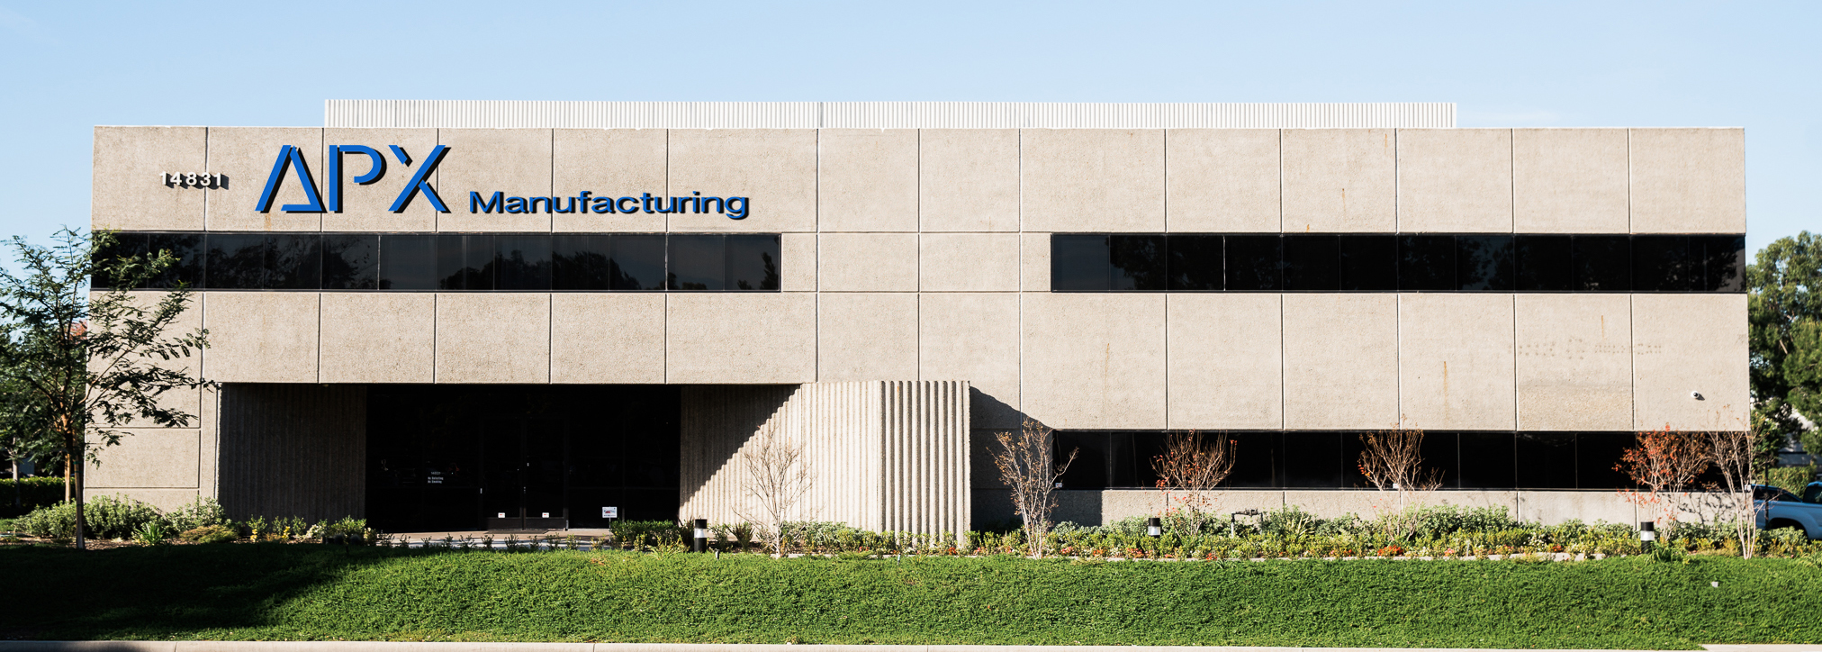
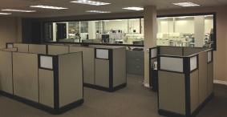
Facility
20,000 square feet
Remodeled to ensure efficient manufacturing
and provide a foundation for growth
Environmentally controlled temperature and humidity
ESD compliant production area
Secured inventory and product management

Slide 4
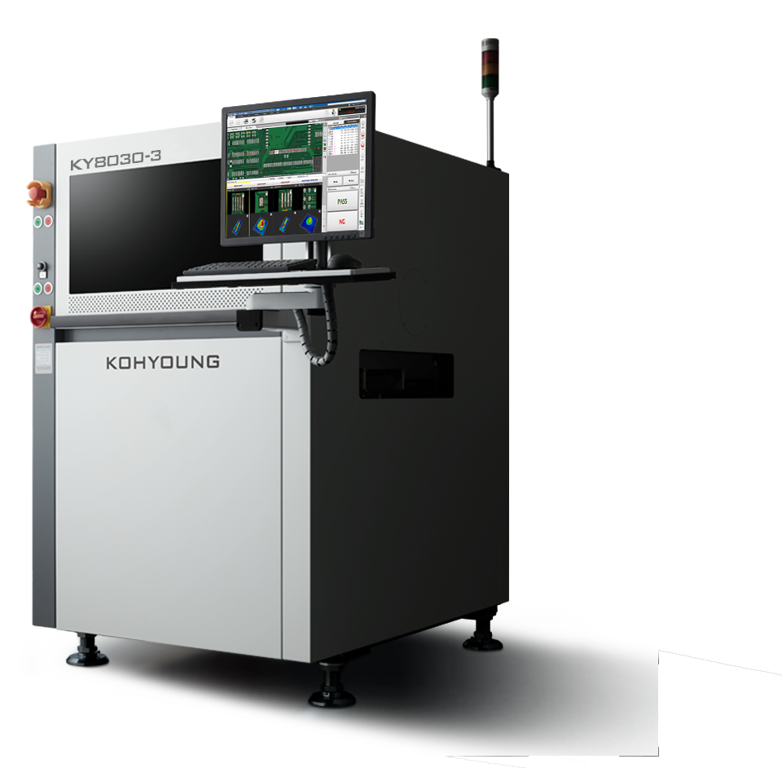
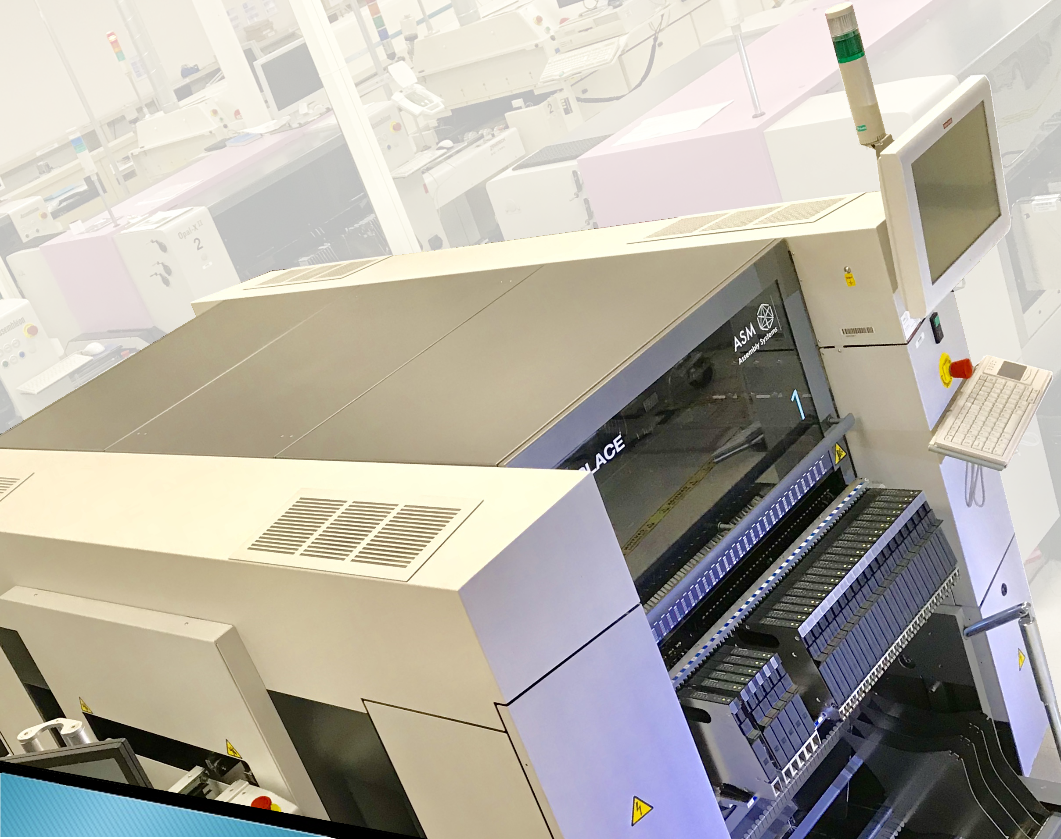
Equipment
SMT Assembly Systems
Assembleon Topaz II & Opal II
ASM SIPLACE SX1 A
29,000 cph
Down to 01005 component placement
Capability of 0201 metric if needed
Koh Young Solder Paste Inspection
Newest SPI model
In-line on multiple lines

Slide 5
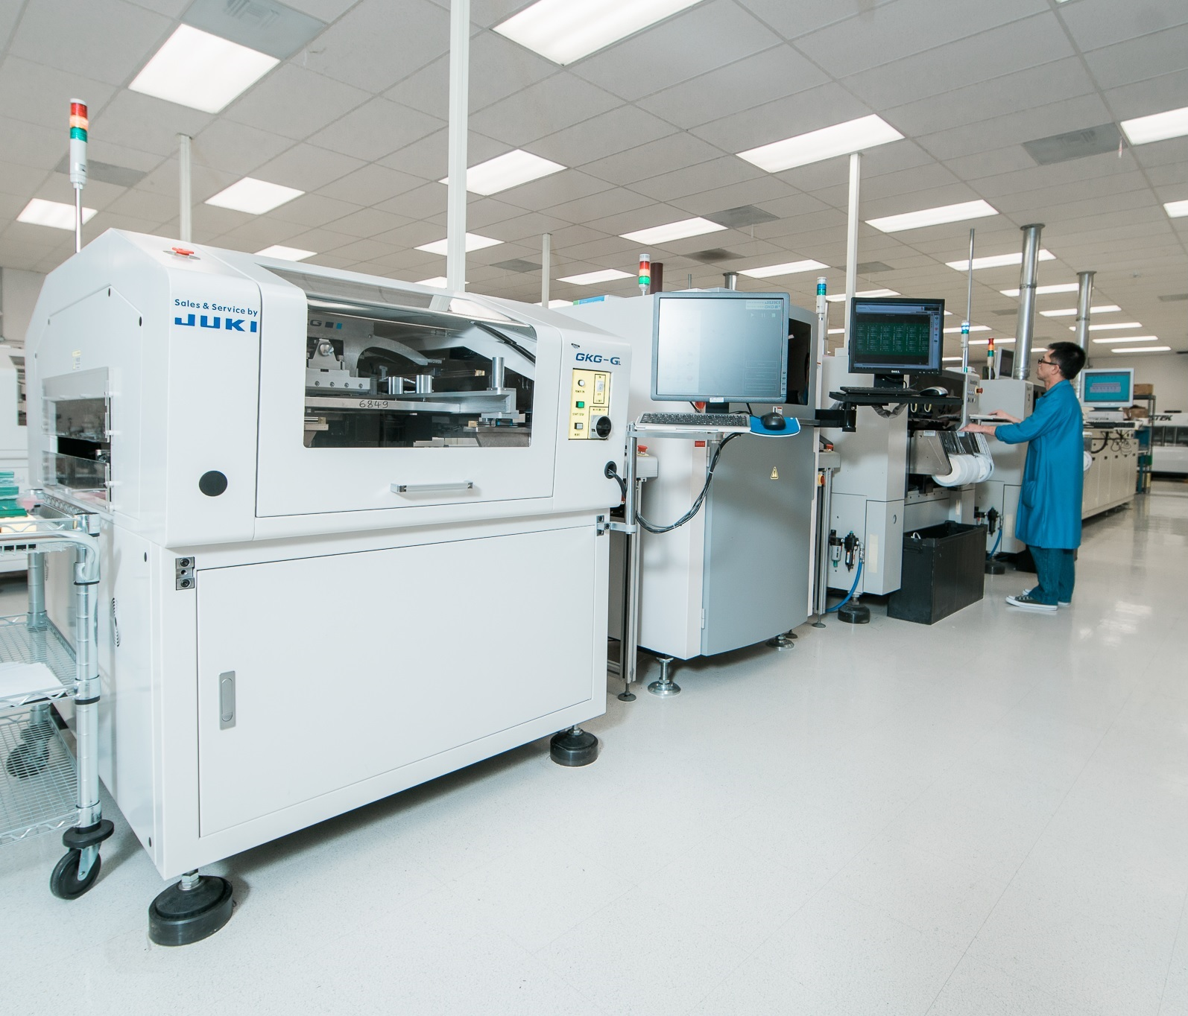
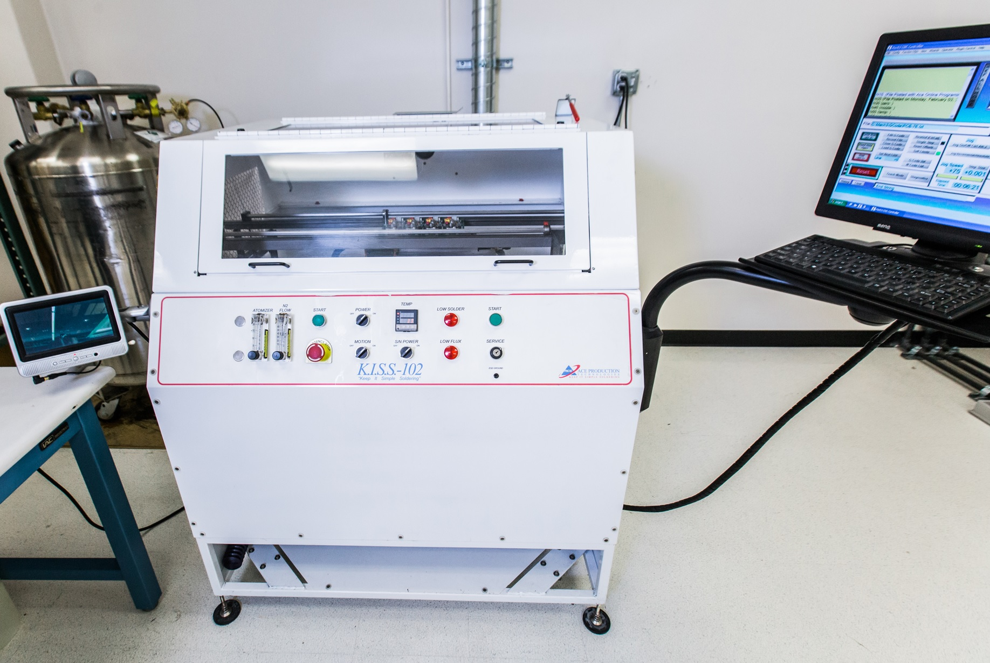
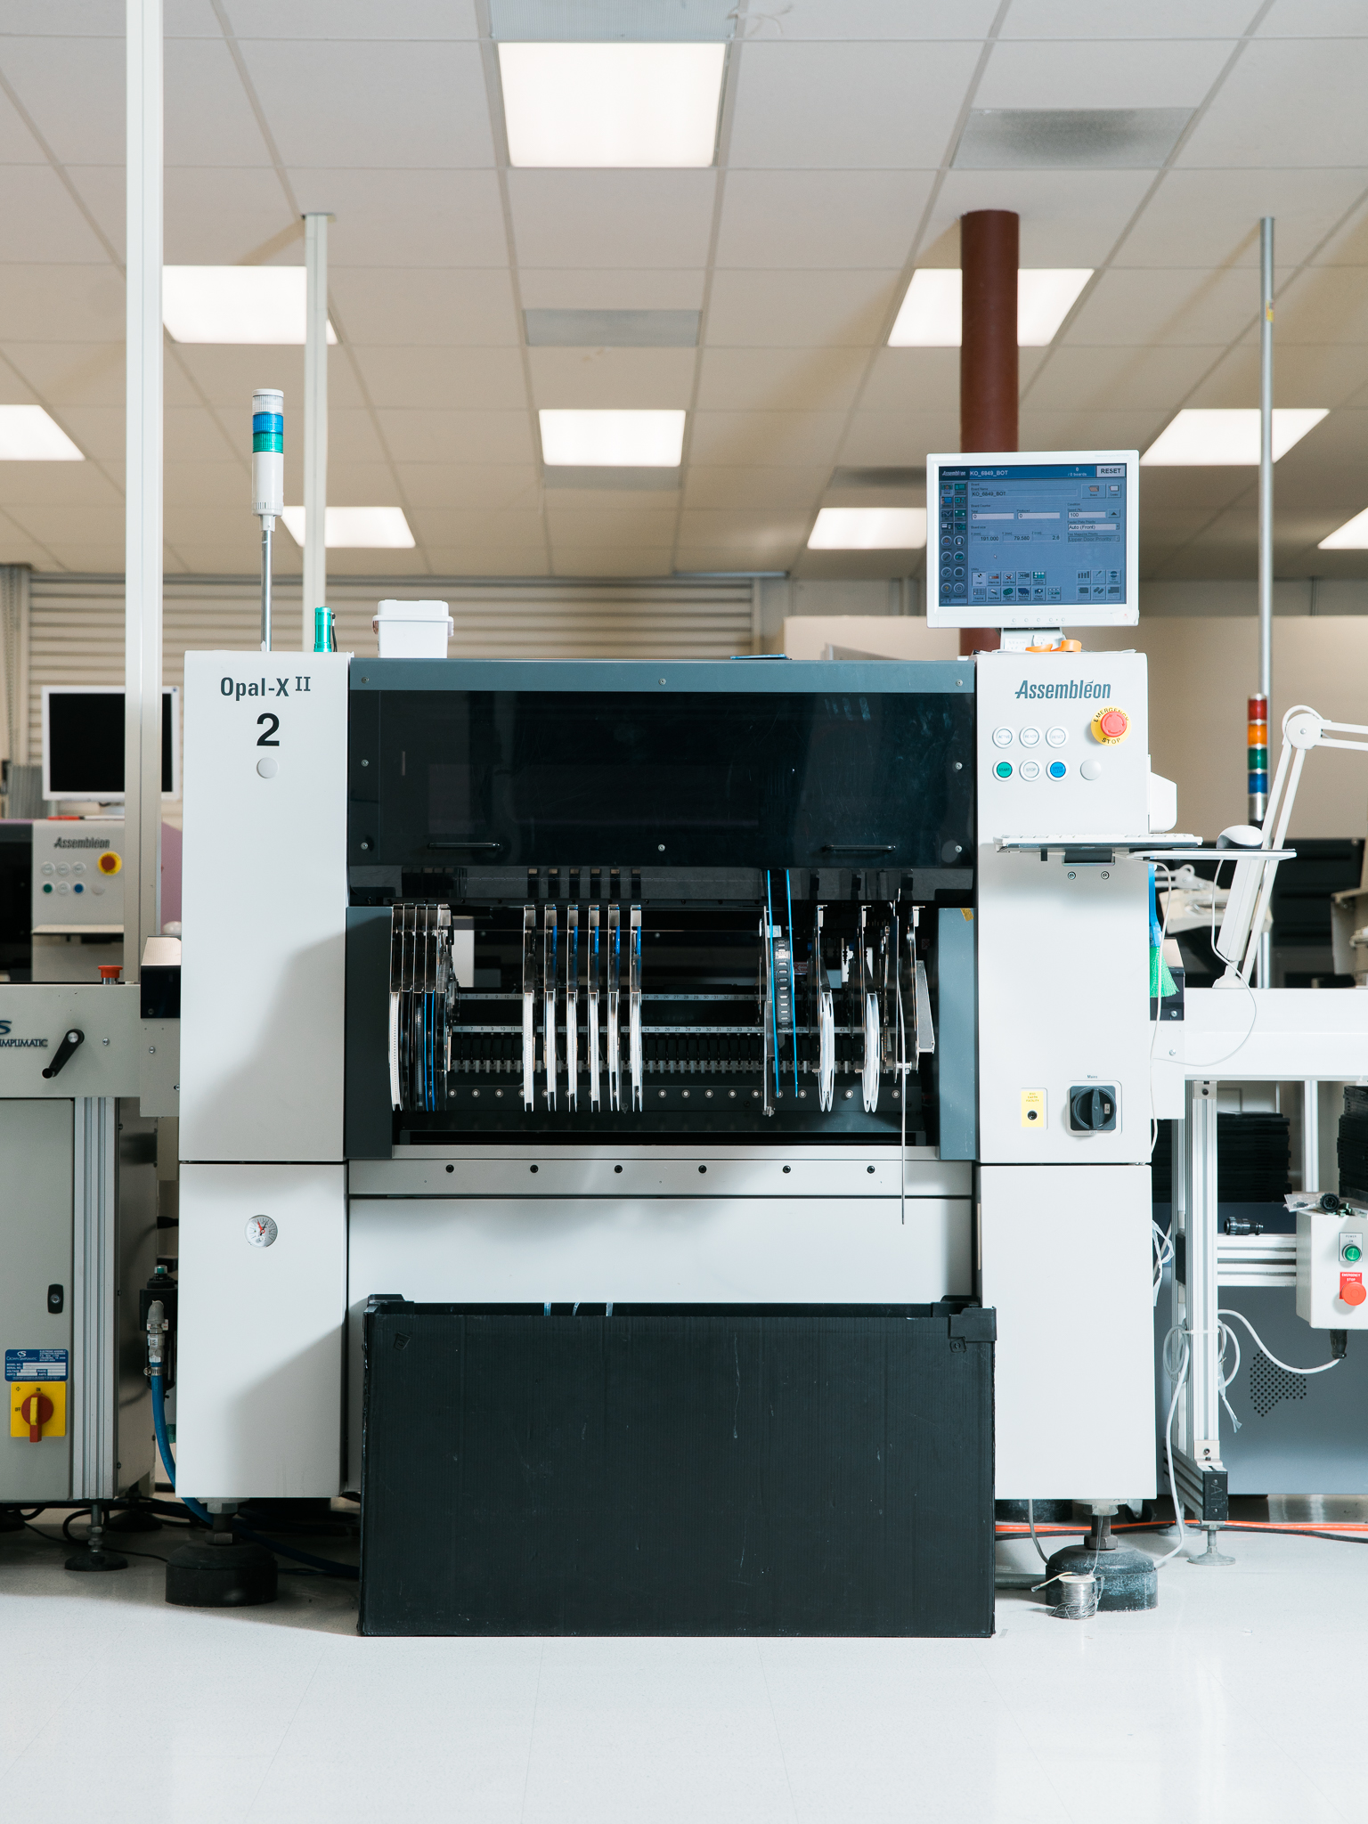
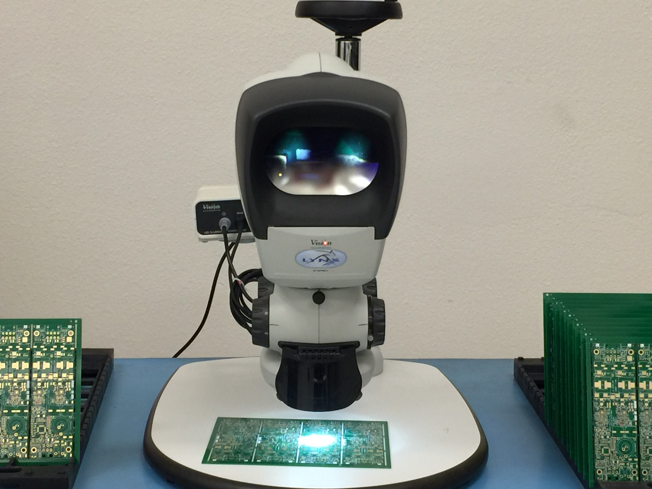
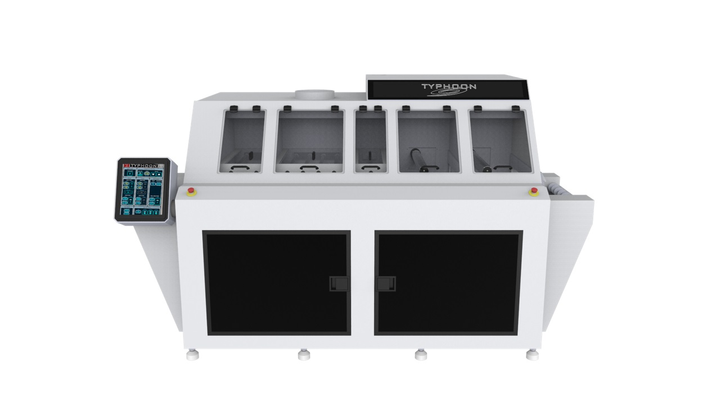
Multiple Lines
Volume vs mix
Fine pitch component placement
Streamlined programming
VJ Electronics X-Ray
Hepco lead trimmer
Maestro 4M Automatic depaneler
Vision Engineering microscopes
Metcal and Hakko Soldering stations
AmeriVac sealer
SMarT Sonic Stencil cleaner
GKG Screen printers
BTU reflow ovens
Each is individually controlled and monitored
ACE selective solder machine
With Nitrogen
Aqueous Tech Wash system
Closed loop DI system
Constant monitoring

Slide 6
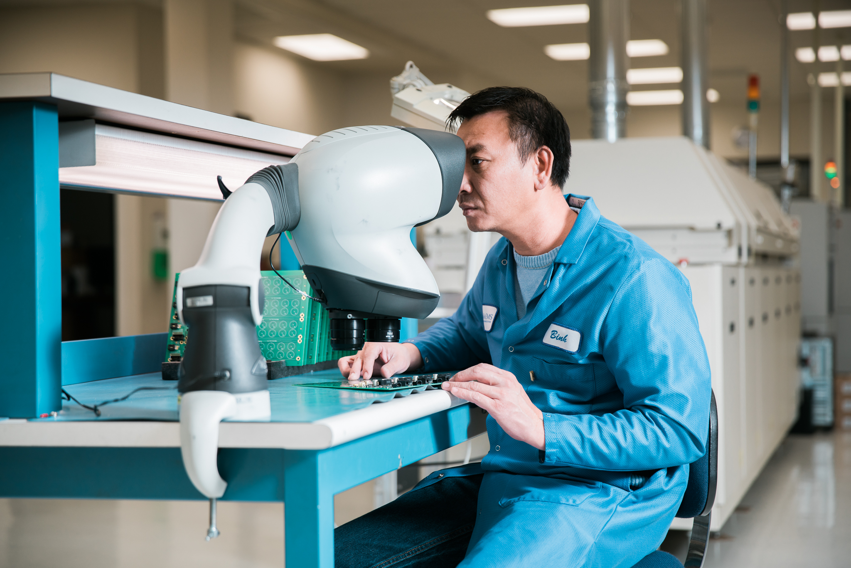
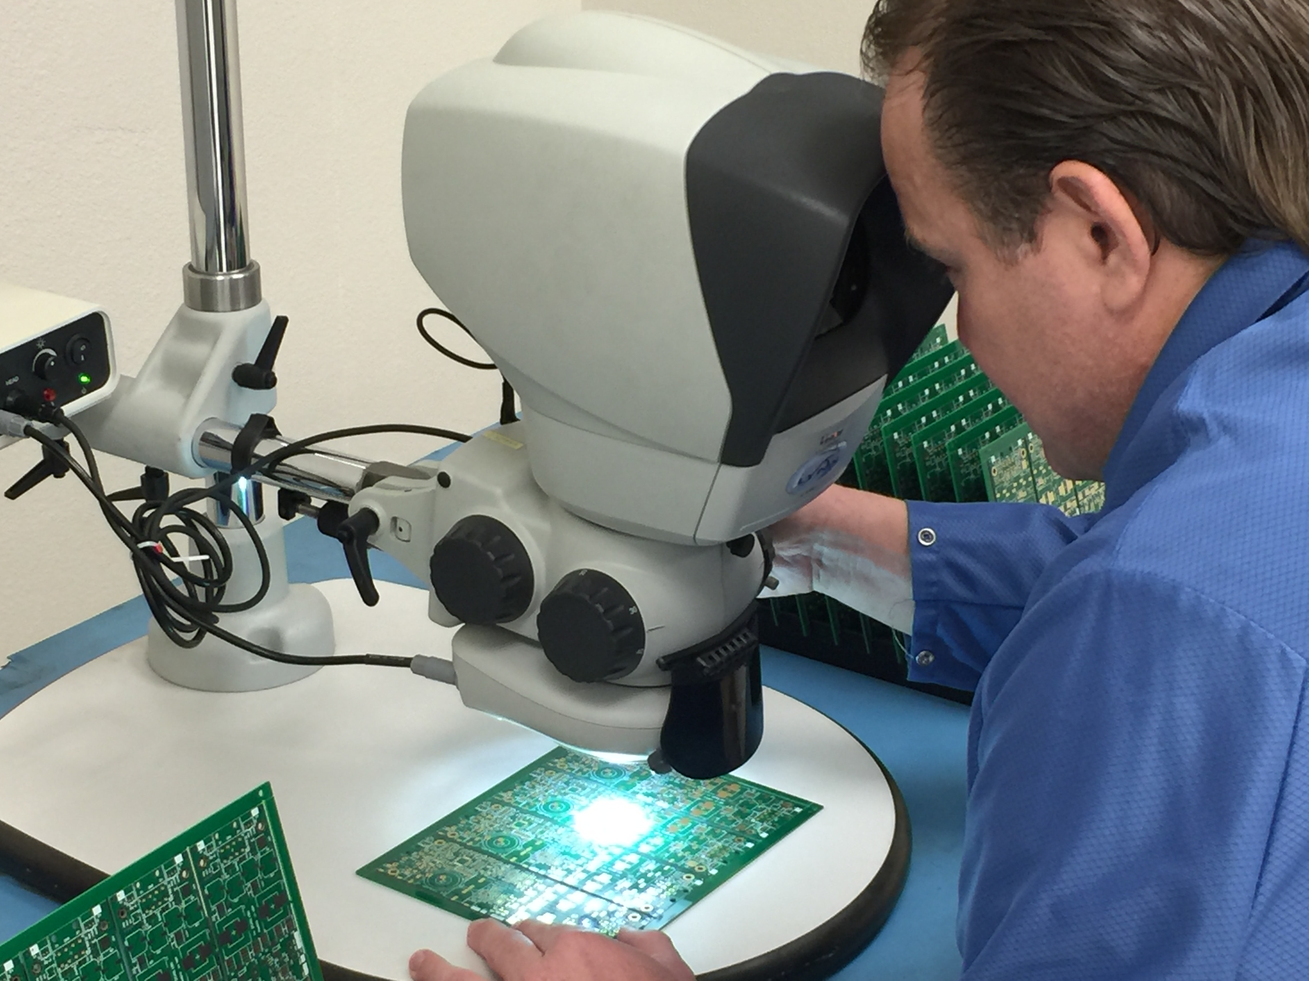
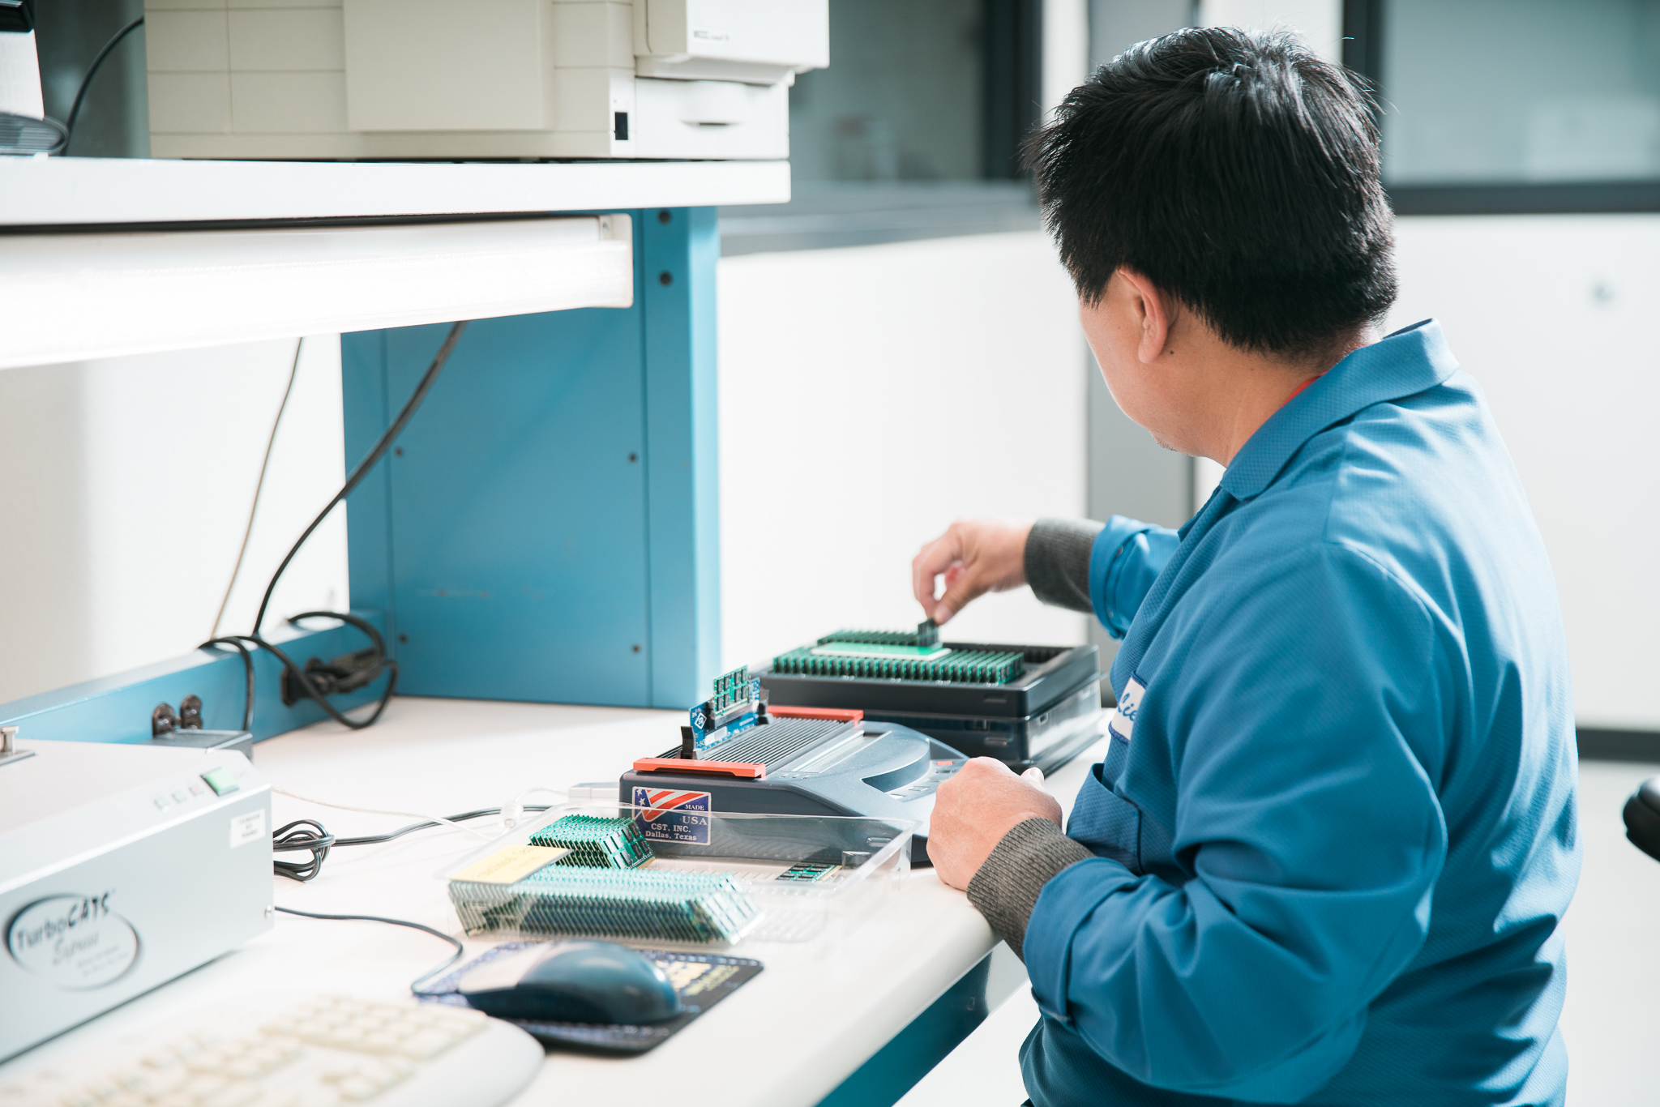
People
Production technicians
with APX for more than 20 years, running our equipment
Engineering and quality control team
with decades of experience and years working with each other
Management staff with years of experience
ensuring that needed resources are available when needed
Executive leadership with nearly 100 years of manufacturing experience
and long standing relationships within the industry

Slide 7
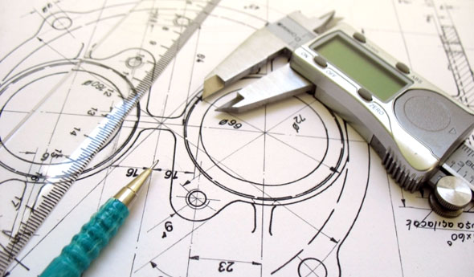
Capabilities
Design
PCB design
Layout
Material selection
DFM services
Materials Management
Full consignment
Full turnkey
Hybrid of consignment/turnkey
Procurement & warehousing

Slide 8
Services
Concept
Assembly
Convert your brilliant idea to schematics
Assemble PCBs at Tustin, California, facility
Design
Testing
Design PCB assembly after analyzing your product
Function or comprehensive testing
Programming of EEPROM or firmware
Layout
PCB layout to ensure assembly efficiency
Final assembly
Procurement
Enclosure assembly and retail packaging
Save customer’s time and money by procuring
materials for their assemblies
Assistance with cabling, procuring specialty plastics and much more!

Slide 9
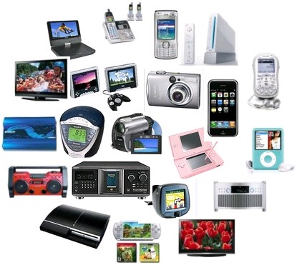
Industries Served
Consumer/Industrial Electronics
Government / Military

Slide 10
Why choose APX?
Innovation
driving improvements
and expanding capabilities
Attention to details
focused on the customer’s directions
&
Industry standards and regulations
Experienced engineers & designers
Scalability to deliver on volume
Warehousing, equipment, or staff
Commitment to building long term relationship

Slide 11
Thank you for your interest & allowing us to present our capabilities

